Slide 1


Slide 2


Project Title
Pre-Final Year Project Synopsis
Submitted by
ROLL | NAME
2401010077 | Divesh kumar kinha
2401010064 | ANIRUDH Anthwal
2401010164 | Anubhav
2401010133 | Deepanshu
Faculty Mentor: Dr. Reenu
Notes:
New Courses replaced with New Programmes

Slide 3

Project Introduction
Nearly 1% of the human population requires a wheelchair for mobility. However, most developing and underdeveloped countries still lack proper wheelchair accessibility.
Wheelchair users are individuals who rely on wheelchairs for mobility due to physical disabilities, injuries, or health conditions. For them, a wheelchair is more than just a device—it is essential for independence, daily functioning, and participating fully in society. Despite advancements in accessibility, wheelchair users often face challenges in navigating public spaces, accessing services, and finding inclusive environments. Supporting their mobility through inclusive design and technology is key to fostering a more accessible and equitable world.
Notes:
New Courses replaced with New Programmes

Slide 4
Abstract
The Wheelchair Guidance and Assistance Website is a comprehensive, user-centric platform designed to support individuals with mobility impairments in navigating their physical environment with greater confidence, safety, and independence. The primary goal of the website is to bridge accessibility gaps by offering real-time tools, informative resources, and interactive features tailored specifically for wheelchair users and caregivers.
The website integrates key functionalities such as an interactive accessibility map, a smart chatbot assistant, and educational content on various challenges faced by wheelchair users. The accessible map leverages location data and user input to display wheelchair-friendly paths, entrances, ramps, elevators, and public facilities. This feature enables users to plan trips and identify obstacles in real-time, contributing to smoother and safer navigation in urban and suburban spaces.
The chatbot is designed using conversational AI to provide 24/7 support. It answers questions related to accessible services, nearby facilities, and legal rights. Additionally, it offers emotional support and quick guidance in case of emergencies, significantly enhancing user independence and confidence.
Notes:
New Courses replaced with New Programmes

Slide 5
The website also includes a knowledge center with curated content on common issues such as inaccessible ramps, public transport limitations, lack of accessible restrooms, and gaps in public awareness. Each topic offers practical advice, policy explanations, and user-contributed solutions to promote community-driven advocacy and shared learning.
A modern, responsive web design ensures that the platform is accessible across devices and screen readers. Compliance with WCAG (Web Content Accessibility Guidelines) ensures usability for individuals with visual or motor impairments.
In summary, the Wheelchair Guidance and Assistance Website is not just a digital tool, but a lifeline for mobility, advocacy, and empowerment. It promotes inclusive living by helping users overcome daily barriers, make informed decisions, and engage with a supportive, informed community.

Slide 6
Problem Statement
Problem Statement:
Individuals who use wheelchairs frequently encounter obstacles that hinder their mobility, independence, and access to essential services. Common issues include the lack of reliable information about wheelchair-accessible venues, difficulty in navigating unfamiliar environments, limited awareness of wheelchair maintenance and user rights, and the absence of immediate support when facing problems related to wheelchair use. These challenges contribute to reduced quality of life, dependence on others, and increased frustration in everyday activities.

Slide 7
Solution
Proposed Solution:
To address these challenges, the Wheelchair Guidance and Assistance System is designed as an all-in-one digital platform that enhances accessibility and support for wheelchair users. The system provides:
Accessible Venues Map: An interactive, GPS-enabled map that helps users identify and locate nearby wheelchair-accessible places such as buildings, transport stations, restrooms, and recreational areas.
Educational Content Hub: Curated resources covering wheelchair usage, maintenance, health and safety tips, accessibility laws, and user rights to empower and educate users.
24/7 Chatbot Assistance: A smart chatbot that offers instant support for wheelchair-related queries, troubleshooting, guidance, and connections to service providers.
This solution promotes independence, reduces uncertainty, and bridges the accessibility gap by offering practical, real-time support and information tailored to the needs of wheelchair users.

Slide 8
Key Features
Interactive Accessibility Map The website includes a GPS-enabled interactive map that displays accessible routes, facilities (like ramps, elevators, and restrooms), and potential obstructions. This map utilizes open-source geographic data and allows users to submit feedback on inaccessible areas, thus creating a dynamic, community-driven resource.
Chatbot Assistance System A key component of the platform is a 24/7 AI-powered chatbot designed to offer both practical assistance and emotional support. Users can ask the chatbot questions related to accessibility, receive recommendations for nearby accessible services (such as restaurants, clinics, transport stations), or learn how to report barriers or incidents.
Informational and Awareness Portal The website hosts a rich library of articles, guides, and tips on issues like:
Choosing the right wheelchair.
Legal accessibility rights.
Safety and emergency protocols.
Notes:
New Courses replaced with New Programmes

Slide 9
Project Usecases
1. Accessible Route Navigation
Actors: Wheelchair users
Description: Users can find and follow routes optimized for wheelchair accessibility using a map interface.
Goal: Avoid stairs, narrow paths, and other barriers by offering safe, navigable routes with ramps, lifts, or flat surfaces.
2. Live Chatbot Support
Actors: Wheelchair users, caregivers, or visitors to new locations
Description: A chatbot answers questions in real time, offering assistance on topics like accessibility rights, nearby facilities, or emergency tips.
Goal: Provide instant help and reduce the user’s dependency on others.
3. Awareness & Education Hub
Actors: Wheelchair users, caregivers, NGOs, city planners
Description: Access guides, tips, and articles on overcoming common wheelchair-related challenges (e.g., dealing with inaccessible transport, choosing the right wheelchair).
Goal: Empower users with knowledge and raise public awareness.
Notes:
New Courses replaced with New Programmes

Slide 10
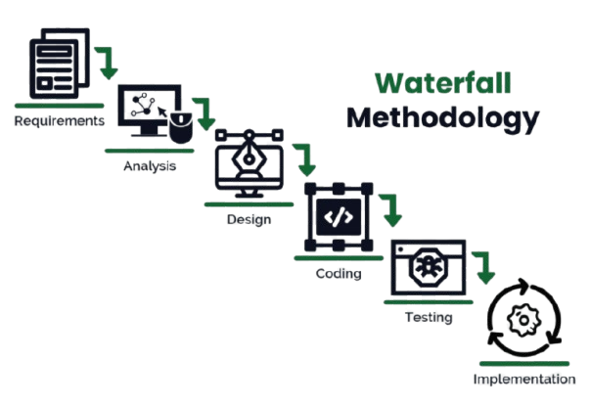
Project Life Cycle
Waterfall Model: It is a classical model used in system development. It is termed as waterfall because the model develops systematically from one phase to another in downward fashion.
Notes:
New Courses replaced with New Programmes

Slide 11
Data & Resources
Category | Tools/Technologies
Frontend | HTML, CSS, JavaScript, React.js, Next.js
Styling | Tailwind CSS, global.css
Maps | Leaflet.js (or Mapbox for future scaling)
Chatbot | Custom JSON data + React-based UI
Accessibility | ARIA roles, semantic HTML, Lighthouse testing
IDE & Versioning | Visual Studio Code, GitHub
Hardware Requirements :
While primarily a web-based platform, the following hardware may be used during development or testing:
Developer Machine: Standard PC or laptop with internet access.
Testing Devices: Mobile phones and tablets for responsive testing.
Wheelchair Simulation / Accessibility Testing Tools:
Optional physical testing with wheelchair users for feedback.
Notes:
New Courses replaced with New Programmes

Slide 12
Methodology
The goal of the project was to provide a user-friendly digital platform that supports individuals using wheelchairs by guiding them through accessible routes, providing assistance through a chatbot, and offering educational content on related issues. To accomplish this, we followed a structured, multi-phase methodology:
1. Problem Analysis and User Requirements:
Understanding Barriers: We analyzed challenges faced by wheelchair users such as:
Inaccessible buildings and streets.
Lack of verified information about accessible public locations.
Difficulty in finding assistance or solutions to wheelchair-related problems.
2. Modular Design Approach:
a. Accessible Map Module
Function: Allows users to view wheelchair-accessible routes and locations.
Method:
Integration with interactive maps (Leaflet.js).
Markers added for accessible locations, curated from open data or manually.
Notes:
New Courses replaced with New Programmes

Slide 13
b. Chatbot Assistance Module
Function: Provides 24/7 conversational assistance to users.
Method:
A JSON-based knowledge tree is used for predefined Q&A.
React components render chatbot responses dynamically.
c. Educational Content Section
Function: Educates users on wheelchair issues, maintenance, rights, and safety.
Method:
Static content organized in HTML/JSX.
May link to videos, documents, or external articles.

Slide 14
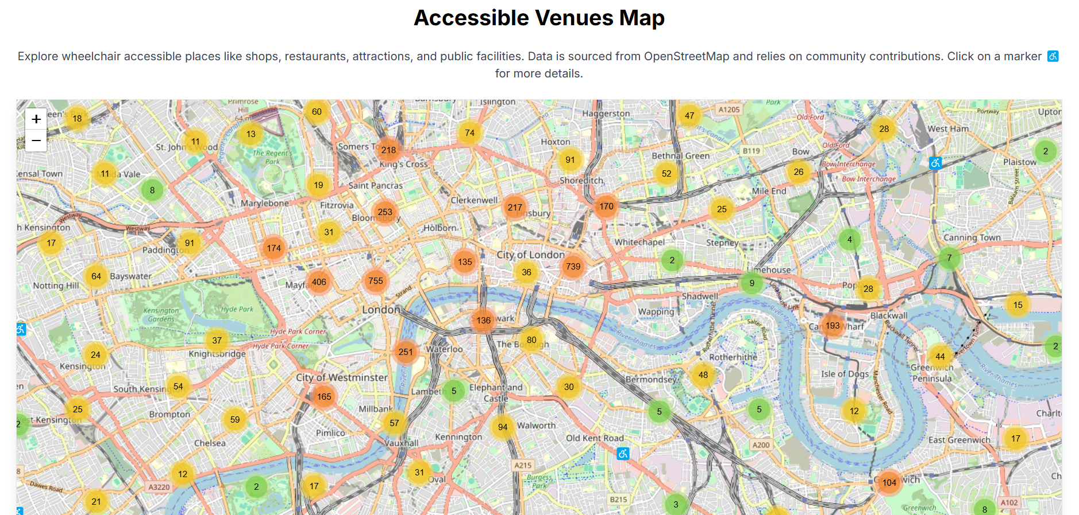
Demonstration

Slide 15
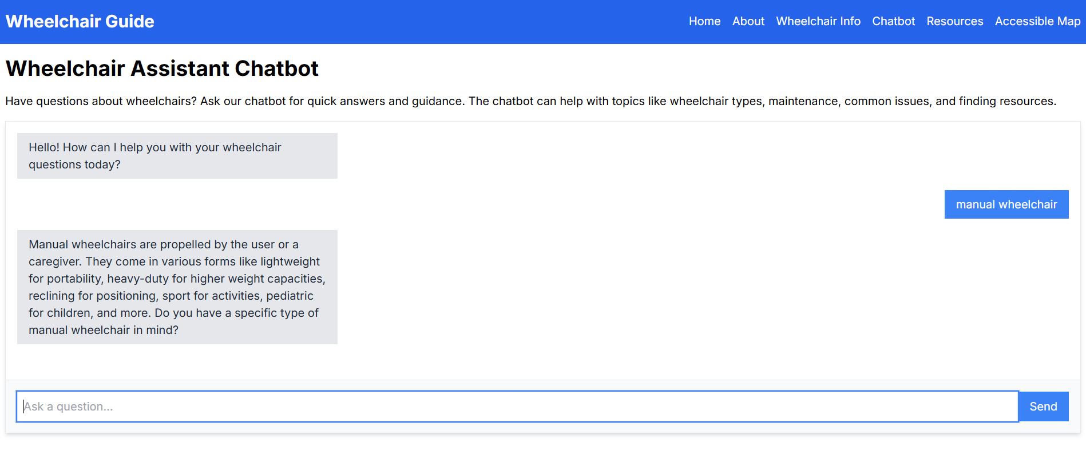

Slide 16
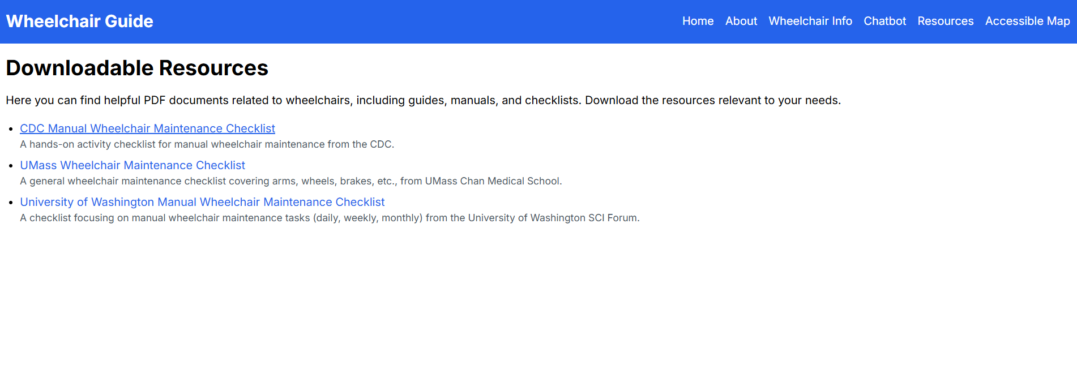

Slide 17
Expected Results & Impact
This platform stands as a meaningful step toward inclusive technology, enabling individuals with mobility impairments to navigate the world with greater freedom and confidence. Beyond personal assistance, the site fosters social equity by making the invisible visible—highlighting infrastructural gaps and advocating for change. With future enhancements such as voice commands, live chat support, and integration with public transport APIs, this system can evolve into a smart mobility assistant and contribute significantly to smart city ecosystems.
Category | Impact
User Experience | Safer, more confident travel and independence for wheelchair users.
Health & Well-being | Reduced physical strain and emotional stress.
Information Access | Immediate, organized help and education via chatbot and content.
Social Inclusion | Increased awareness and participation in public life.
Policy Influence | Encourages organizations to become more accessible and inclusive.
Tech Adoption | Promotes the use of inclusive design and assistive technologies.
Notes:
New Courses replaced with New Programmes

Slide 18
Future Enhancements
Voice-controlled chatbot
Multi-language support
Integration with smart city infrastructure
Accessibility heatmaps based on user ratings
Partnerships with municipalities and NGOs for live accessibility updates.

Slide 19
THANK YOU

